Slide 1
Third Grade Curriculum Night
September 20, 2010
AB Combs Leadership Magnet Elementary
Janet Pride
Chris Hahner
Kate Garrison
Paula Everett
Kim Hefelfinger
Barbara Watkins

Slide 2
Quality Process
+
Agenda
Issue Bin
Plus/Delta

Slide 3
Wildly Important Goals (W.I.G.s)
Student Achievement
Leadership Opportunities
Lead
Learn
Serve
Notes:
This year our school’s Wildly Important Goals focus on
Student Achievement and 2) Leadership Opportunities
All students should be able to explain how they Lead, Learn and Serve at Combs

Slide 4
Third Grade Mission Statement
We will show each student love and encouragement by challenging and motivating their physical, mental and social growth.

Slide 5
Literacy Warm Up
There’s a Bug
on the Teacher!
By: Kalli Dakos
Notes:
K-2, students learn to read
3-5, students read to learn
What does that mean?
They aren’t as focused on decoding each word anymore.
This year we will be:
Helping students to clearly express their thinking as readers
Teaching students how to be engaged readers
One of the many bridges to comprehension is Fluency
Fluency
P - Phrasing
A - Accuracy
C - Comprehension
E - Expression
Teacher(s): Read poem without fluency
Parents: Read poem with fluency (helps you to understand the meaning of what you read MUCH quicker)
Ex: She secretly slipped the disgusting rodent into his soup!

Slide 6
3rd Grade Curriculum Resources
http://www.wcpss.net/parents_students.html
Handbooks, Planning Guides & Program Information
K-8 Connections

Slide 7
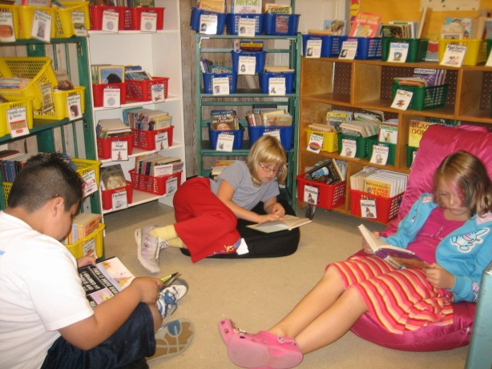
Balanced Literacy Framework
Reader’s Workshop
Guided Reading & Conferring
Writer’s Workshop
Word Study & Vocabulary
Notes:
Various components of literacy throughout our day
Whole group, small group, one-on-one conferring
Modeling Explicit Language, Specific Skills and Strategies

Slide 8
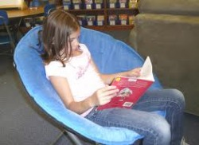
Reader’s Workshop
Workshop Cycle Learning & Instruction
Mini-lesson
Student Application
read, respond, confer
Reflection
Primary focus
Creating a community of readers & thinkers
Vocabulary Instruction
Flexible Reading Strategies
Decoding & Comprehension Skills
Increase Fluency & Reading Stamina

Slide 9
Word Study & Vocabulary
Words, words and more words!
Learning spelling patterns
Bi-weekly word family quizzes
Differentiated student lists
Improves
student decoding abilities
spelling and writing
Vocabulary Instruction
Quick Check
Notes:
Words, Words and more words (Word Families, Science and Math Word Walls, Sight words, Vocabulary, Personal Word Walls, etc. )

Slide 10
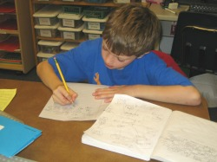
Writer’s Workshop
Genres
Lists and Instructions
Poetry
Letter writing
Personal Narrative
Informational Writing
Continuous Cycle
Planning
Drafting
Revising
Editing
Publishing

Slide 11
First Quarter Expectations
I used complete sentences. | I used correction punctuation & capitalization. | I wrote a focused story on one topic.
My story has a beginning, middle and end. | First Quarter Writing Expectations | I indented the paragraphs.
I used descriptive words. | I re-read my story and made any changes needed. | I spelled the first 200 sight words correctly.

Slide 12
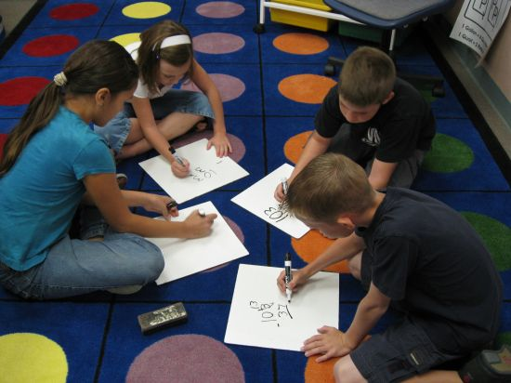
Math Workshop
Math Expressions
Building concepts
Math Talk
Quick Practice
Student Leaders
Helping Community
Multi-digit Addition & Subtraction, Multiplication, Geometry, Algebra, Fractions, Measurement & Problem Solving

Slide 13
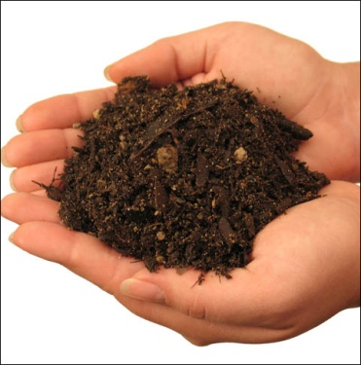
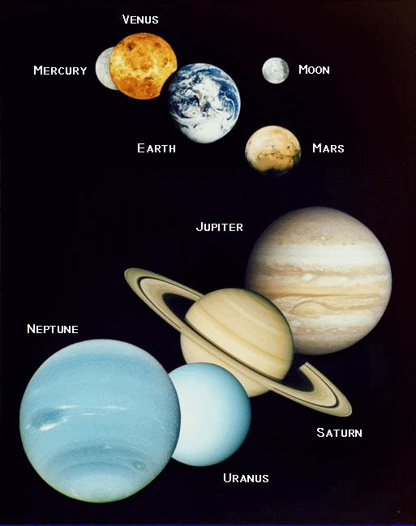
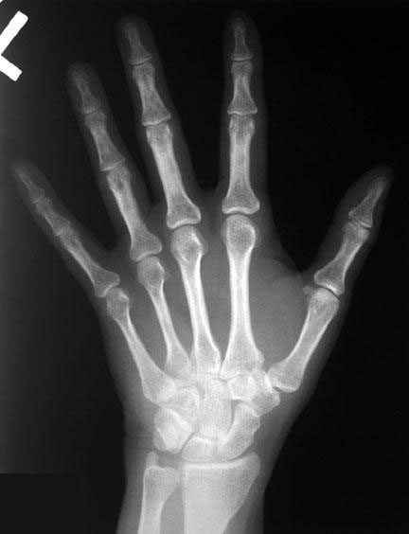
Science
Soils
Objects in the Sky
Plants
The Human Body

Slide 14
W.O.W.
Math Focus
Differentiation
Remediation, Review & Enrichment
Practice Essential Skills
Small Groups
FUN!

Slide 15
Homework
Hallmarks of Good Homework
Agendas
Nightly Reading
Math Expressions
Word Study
Notes:
Hallmarks of Good Homework (According to Educational Leadership – September Article)
Purpose
Efficiency
Ownership
Competence
5) Aesthetic Appeal
Agendas: STUDENT Responsibility, Parents – please sign NIGHTLY

Slide 16
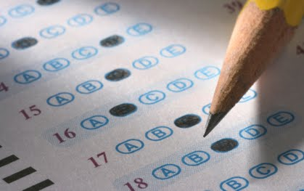
3rd Grade Expectations
Meet quarterly benchmarks
Standards based grading (3 or higher)
Achieve a reading level of 31-32
Achieve a level 3 or 4 on EOG’s

Slide 17
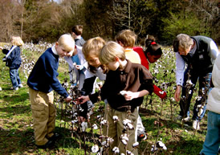
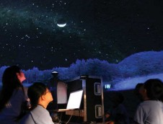
Field Trips
Historic Oak View County Park (Nov)
STARLAB (Dec at AB Combs)
Marbles Museum (Spring)

Slide 18
Quizdom! What do you know about third grade ?

Slide 19
Quality Process
+
Issue Bin
Plus/Delta

Slide 20
Please join us in your child’s classroom for the second half of Curriculum Night.
Teacher Room #
Hefelfinger 221
Everett 223
Hahner 412
Garrison 413
Watkins 414
Pride 415

